Slide 1

Introduction to Data Analysis
Foundations and Key Concepts
Objectives:
- Understand the fundamentals of data analysis.
- Differentiate between data analysis and data analytics.
- Learn the different types of data analysis.
- Understand the data analysis workflow and data types.

Slide 2
What is Data Analysis?
- The process of inspecting, cleaning, transforming, and modeling data.
Helps in discovering useful information, making decisions, and predicting trends.
Used in business, healthcare, and finance.

Slide 3
Data Analysis vs. Data Analytics
Feature | Data Analysis | Data Analytics
Focus | Understanding past data | Making future predictions
Goal | Extract insights | Improve decision-making
Example | Analyzing sales trends | Predicting future sales

Slide 4
Why Data Analysis?
Importance in various fields: Business, healthcare, finance, science, social sciences, etc. Note: Applicable to almost any domain with data.
Key benefits: Improved decision-making, identification of patterns and trends, risk reduction, increased efficiency, development of new products and services. Note: Creates a competitive advantage.

Slide 5

Take 3-4 minutes and think about two examples of data benefits in healthcare and finance? Write it down with you for discussion

Slide 6
Types of Data Analysis
- Descriptive Analysis: What happened?
- Diagnostic Analysis: Why did it happen?
- Predictive Analysis: What can happen in the future?
- Prescriptive Analysis:What actions should we take?
Can you think of example of each of above??? Take 5 minutes and write down examples

Slide 7
Examples
Descriptive Analysis (What happened?)
Example: A retail store analyzes last quarter's sales data to determine that the best-selling product was a specific brand of sneakers.
Use Case: Summarizing past performance, like total revenue, customer demographics, or website traffic.

Slide 8
Examples
Diagnostic Analysis (Why did it happen?)
Example: A company notices a sudden drop in sales and investigates factors like customer feedback, competitor activity, and economic changes to determine the cause.
Use Case: Identifying reasons for business outcomes, such as a decline in customer satisfaction or increased product returns.

Slide 9
Examples
Predictive Analysis (What can happen in the future?)
Example: An e-commerce site uses historical purchase data to predict which products will be in high demand during the holiday season.
Use Case: Forecasting future trends, such as customer churn, stock market movements, or disease outbreaks.
.

Slide 10
Examples
Prescriptive Analysis (What actions should we take?)
Example: A ride-sharing app uses real-time traffic and demand data to suggest optimal surge pricing and driver deployment.
Use Case: Providing recommendations for action, such as optimizing marketing strategies, setting dynamic pricing, or improving customer engagement.

Slide 11
Process Flow of Data Analysis
- Requirements Gathering & Planning
- Data Collection
- Data Cleaning
- Data Preparation
- Data Analysis
- Data Interpretation & Result Summarization
- Data Visualization

Slide 12
Examples of each stage
Requirements Gathering & Planning
Example: A retail company wants to understand customer purchasing behavior to improve its marketing strategy.
Process: Define objectives, stakeholders, required data sources, and success criteria.

Slide 13
Data Collection
Example: The company gathers transaction data from its sales database, customer feedback from surveys, and website clickstream data.
Process: Extract data from multiple sources like databases, APIs, web scraping, or sensors.

Slide 14
Data Cleaning
Example: The collected sales data has missing customer IDs and duplicate transactions, which need to be fixed.
Process: Handle missing values, remove duplicates, correct inconsistencies, and standardize formats.

Slide 15
Data Preparation
Example: Convert date formats, categorize customer age groups, and merge data from different sources into a structured dataset.
Process: Transform, normalize, and structure data for analysis, ensuring it's ready for processing.

Slide 16
Data Analysis
Example: Perform exploratory data analysis (EDA) to identify purchasing patterns and segment customers based on buying behavior.
Process: Apply statistical methods, machine learning models, or business intelligence tools to derive insights.

Slide 17
Data Interpretation & Result Summarization
Example: Analysts discover that repeat customers tend to buy more during holiday seasons, suggesting a loyalty trend.
Process: Summarize key findings, explain patterns, and relate insights to business objectives.

Slide 18
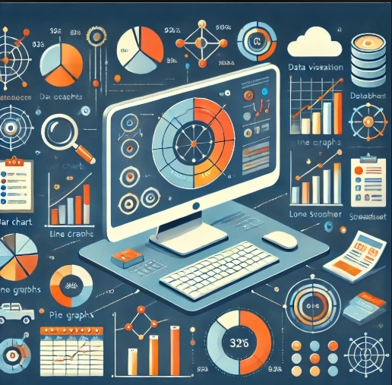
Data Visualization
Example: Create a dashboard with bar charts, heat maps, and line graphs showing sales trends and customer demographics.
Process: Use visualization tools (e.g., Tableau, Power BI, Matplotlib, Seaborn) to communicate insights effectively.

Slide 19
Types of Data
Structured Data Organized in tables (e.g., Excel, SQL databases).
Semi-structured Data:Partially organized (e.g., JSON, XML, CSV).
Unstructured Data: No predefined format (e.g., images, videos, social media posts).

Slide 20
File Formats in Data Analysis
CSV: Widely used for structured data.
JSON: Used in web applications and APIs.
XML: Common for data exchange.
Excel: Popular in business data processing.
Databases (SQL, NoSQL): Large-scale data storage.

Slide 21
Python Libraries for Data Analysis
NumPy : Numerical computing.
Pandas: Data manipulation and analysis.
Matplotlib: Basic visualization.
Seaborn: Advanced visualization.
Scikit-learn: Machine learning models.
We will discuss the examples of each of these libraries in the following slides

Slide 22
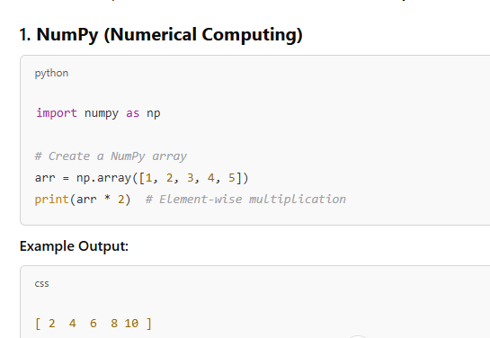

Slide 23
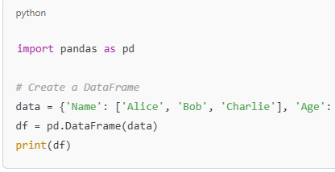
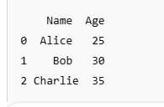
Pandas (Data Manipulation and Analysis)

Slide 24
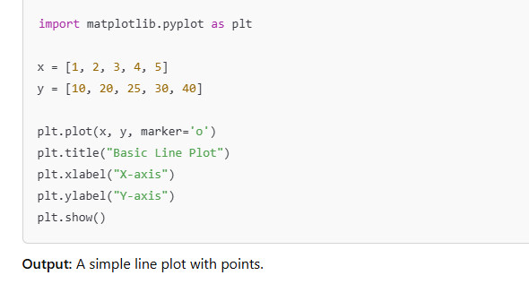
MatplotLib

Slide 25
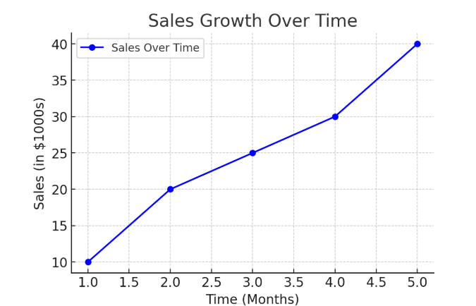
Example of line chart

Slide 26
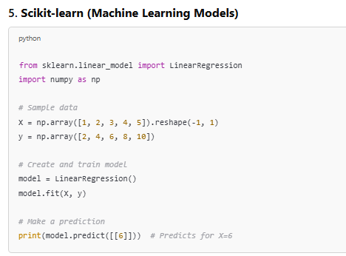
Example of Scikit-Learn Code

Slide 27
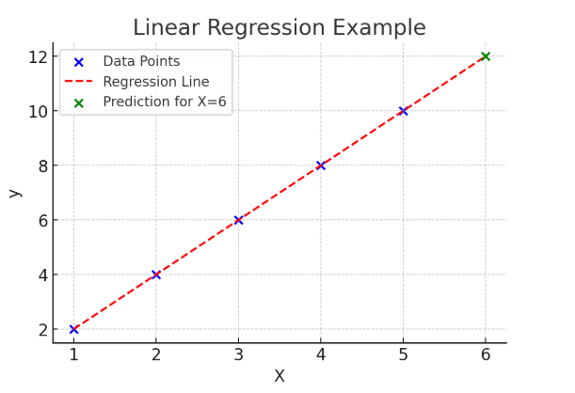
Example output

Slide 28
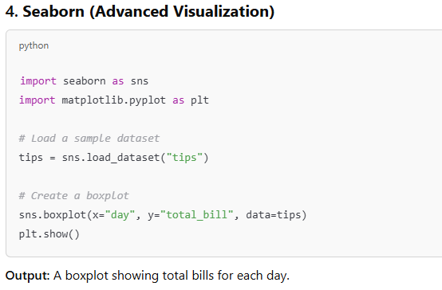

Slide 29
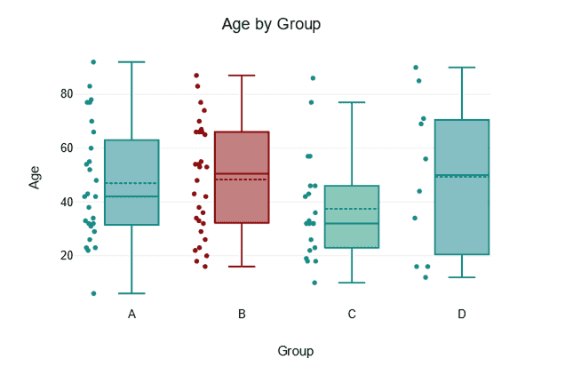
Example of Boxplot

Slide 30
Summary
- Data analysis helps in decision-making and discovering trends.
- Four main types: descriptive, diagnostic, predictive, prescriptive.
- Process involves multiple stages from data collection to visualization.
- Understanding data formats and Python libraries is key.

